Slide 1
Potential and Kinetic Energy Notes

Slide 2
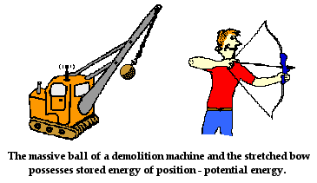
Potential Energy
Three examples of potential energy are elastic potential energy, chemical energy, and gravitational potential energy.
An object may store energy by virtue of its position.
Energy that is stored and held in readiness is called potential energy (PE) because in the stored state it has the potential for doing work.

Slide 3
Elastic Potential Energy
A stretched or compressed spring has a potential for doing work.
When a bow is drawn back, energy is stored in the bow. The bow can do work on the arrow.
A stretched rubber band has potential energy because of its position.
These types of potential energy are elastic potential energy.

Slide 4
Chemical Energy
The chemical energy in fuels is also potential energy.
It is energy of position at the submicroscopic level.
This energy is available when the positions of electric charges within and between molecules are altered and a chemical change takes place.

Slide 5

Gravitational Potential Energy
Work is required to elevate objects against Earth’s gravity.
The potential energy due to elevated positions is gravitational potential energy.
Water in an elevated reservoir and the raised ram of a pile driver have gravitational potential energy.

Slide 6
Potential Energy Calculation
The amount of gravitational potential energy possessed by an elevated object is equal to the work done against gravity to lift it.
The upward force required while moving at constant velocity is equal to the weight, mg, of the object, so the work done in lifting it through a height h is the product mgh.
gravitational potential energy = weight × height
PE = mgh

Slide 7
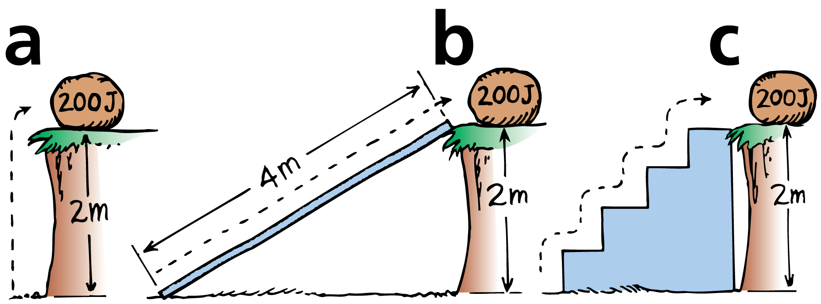
Potential Energy Examples
The potential energy of the 100-N boulder with respect to the ground below is 200 J in each case.
The boulder is lifted with 100 N of force.
The boulder is pushed up the 4-m incline with 50 N of force.
The boulder is lifted with 100 N of force up each 0.5-m stair.

Slide 8
Hydroelectric Power and Potential Energy
Hydroelectric power stations use gravitational potential energy.
Water from an upper reservoir flows through a long tunnel to an electric generator.
Gravitational potential energy of the water is converted to electrical energy.
Power stations buy electricity at night, when there is much less demand, and pump water from a lower reservoir back up to the upper reservoir. This process is called pumped storage.
The pumped storage system helps to smooth out differences between energy demand and supply.

Slide 9
think!
You lift a 100-N boulder 1 m.
a. How much work is done on the boulder?
b. What power is expended if you lift the boulder in a time of 2 s?
c. What is the gravitational potential energy of the boulder in the lifted position?

Slide 10
think!
You lift a 100-N boulder 1 m.
a. How much work is done on the boulder?
b. What power is expended if you lift the boulder in a time of 2 s?
c. What is the gravitational potential energy of the boulder in the lifted position?
Answer:
a. W = Fd = 100 N·m = 100 J
b. Power = 100 J / 2 s = 50 W
c. Relative to its starting position, the boulder’s PE is 100 J. Relative to some other reference level, its PE would be some other value.

Slide 11

Kinetic Energy
The kinetic energy of a moving object is equal to the work required to bring it to its speed from rest, or the work the object can do while being brought to rest.

Slide 12
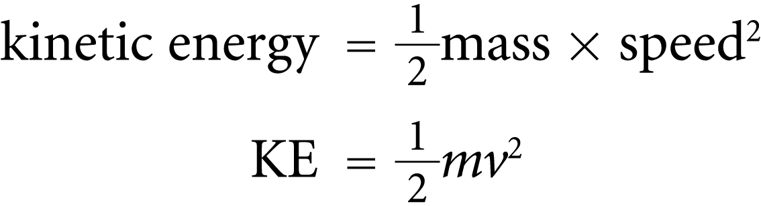
Kinetic Energy Calculations
If an object is moving, then it is capable of doing work. It has energy of motion, or kinetic energy (KE).
The kinetic energy of an object depends on the mass of the object as well as its speed.
It is equal to half the mass multiplied by the square of the speed.

Slide 13
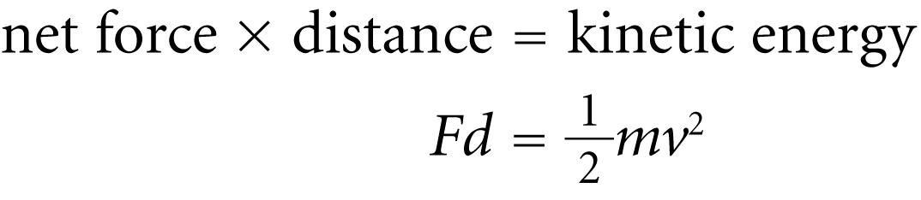
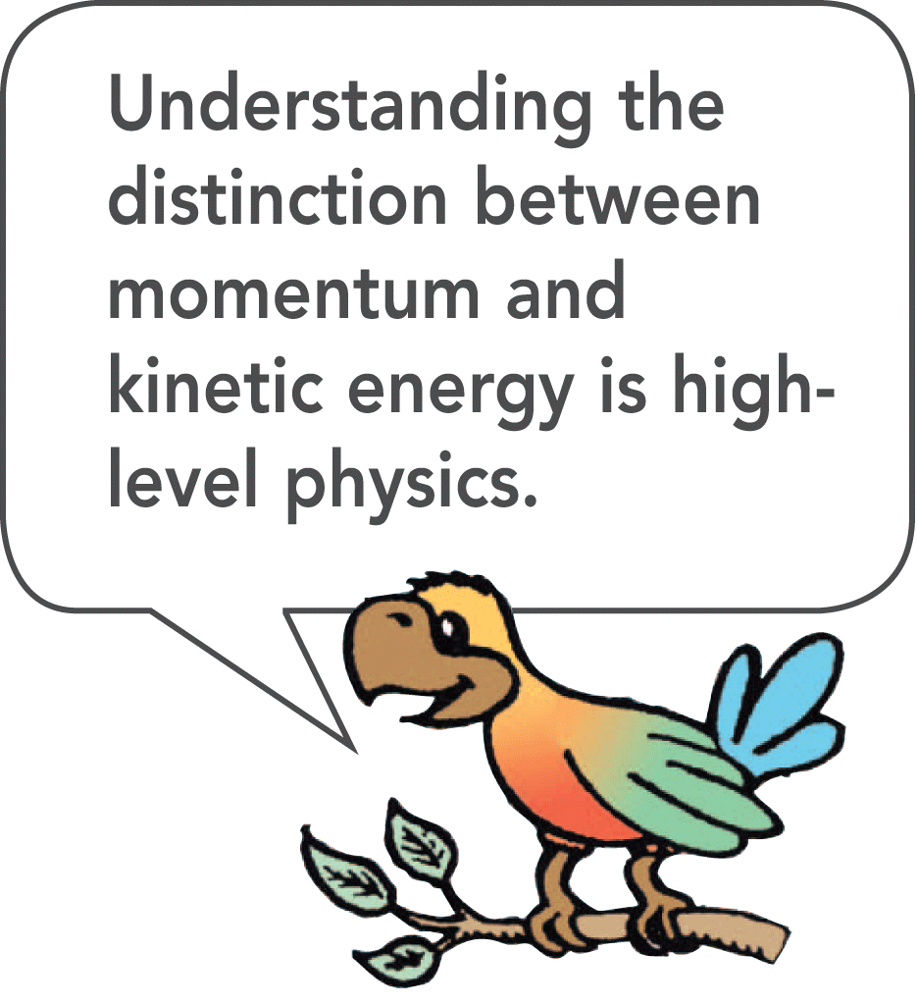
Kinetic Energy Calculations
When you throw a ball, you do work on it to give it speed as it leaves your hand. The moving ball can then hit something and push it, doing work on what it hits.

Slide 14
Work-Energy Theorem
The work-energy theorem states that whenever work is done, energy changes.
To increase the kinetic energy of an object, work must be done on the object.
If an object is moving, work is required to bring it to rest.
The change in kinetic energy is equal to the net work done.
The work-energy theorem describes the relationship between work and energy.

Slide 15
Work-Energy Theorem
We abbreviate “change in” with the delta symbol, ∆
Work = ∆KE
Work equals the change in kinetic energy.
The work in this equation is the net work—that is, the work based on the net force.

Slide 16
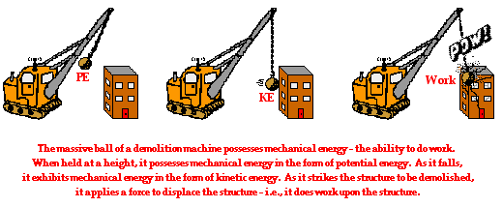
Work-Energy Theorem

Slide 17
Conservation of Energy
The law of conservation of energy states that energy cannot be created or destroyed. It can be transformed from one form into another, but the total amount of energy never changes.

Slide 18
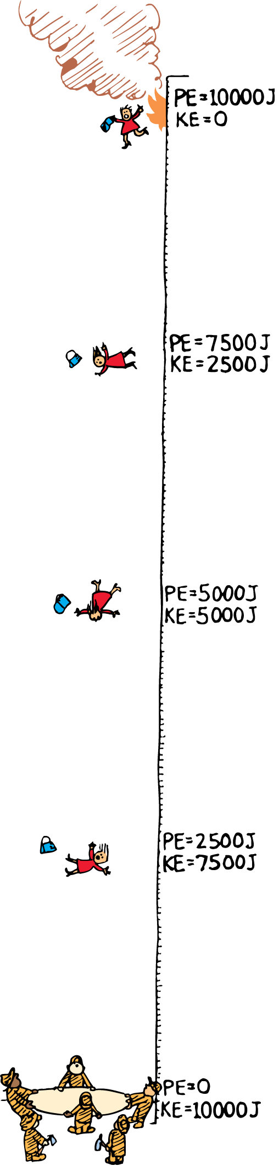
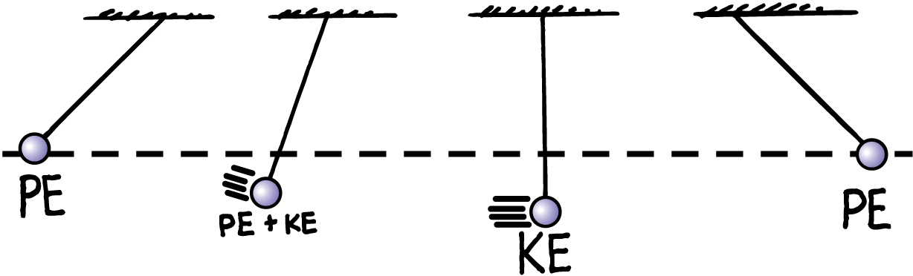
Conservation of Energy Examples

